Slide 1
GEOG-G489/589 Python Programming
Instructor: Natasha MacBean
Final word on NetCDF and Intro to Cartopy

Slide 2
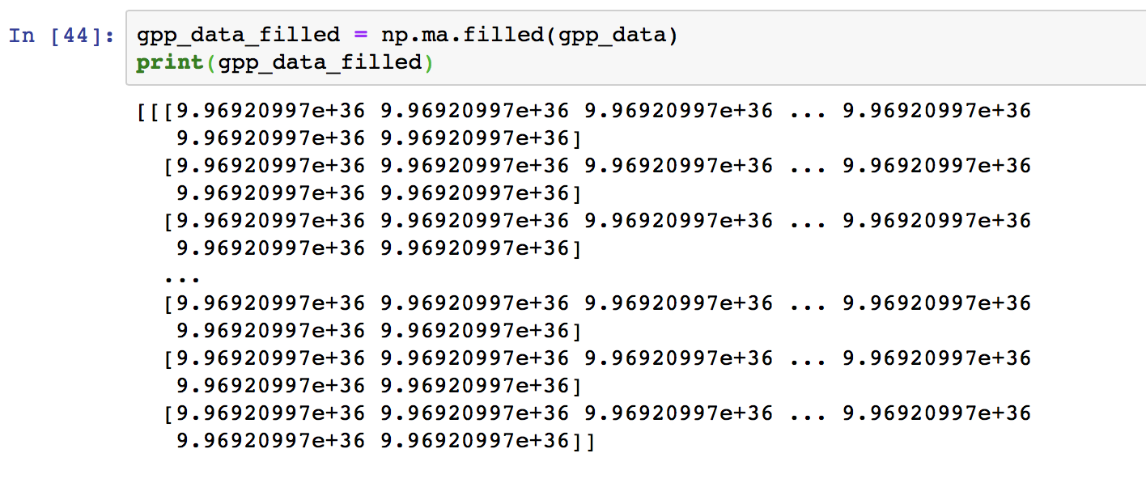
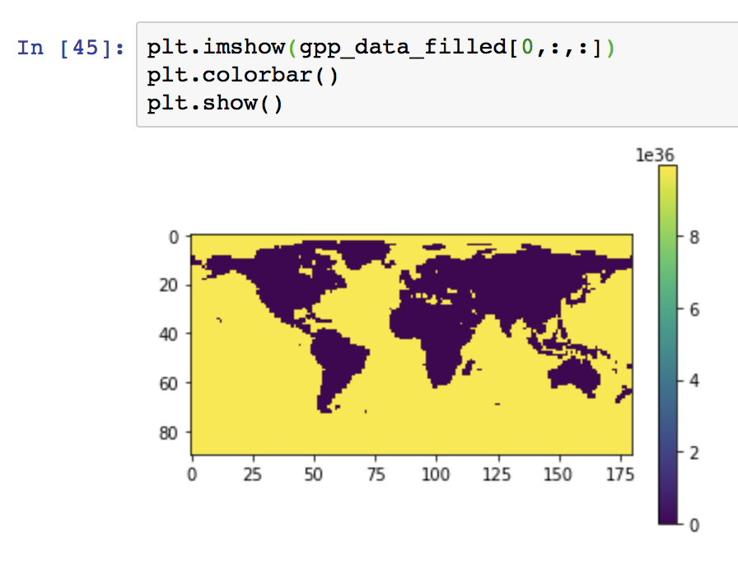
More on masked arrays

Slide 3
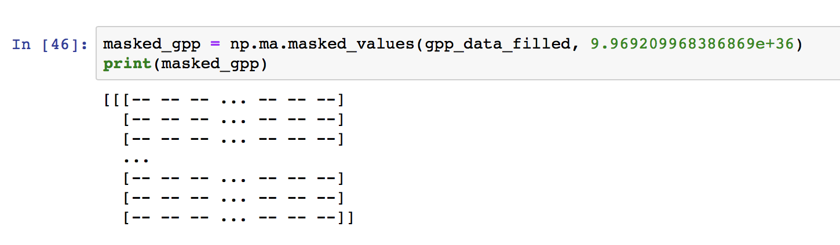
Creating masked arrays: np.ma.masked_values(arr, value)

Slide 4
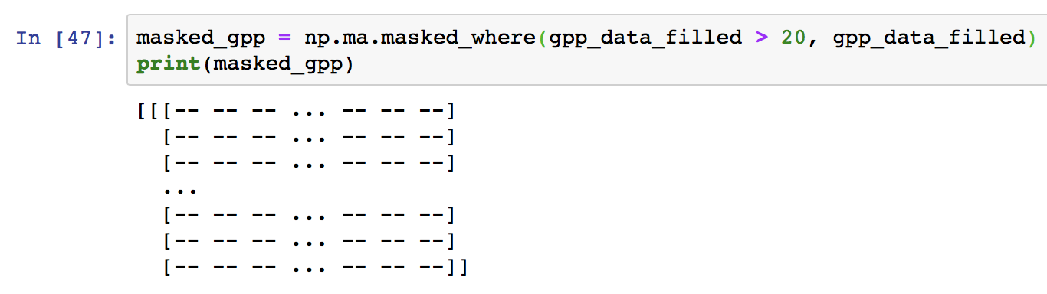
Creating masked arrays: np.ma.masked_where(cond, arr)

Slide 5
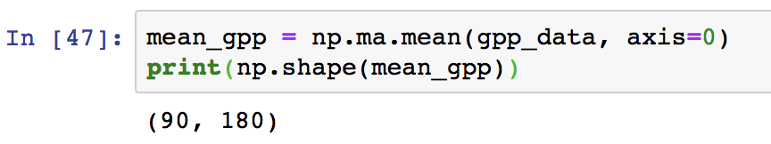
np.mean with axis keyword
Specify which dimension you want to take the mean over
NOTE: we use np.ma.mean because this is a masked array
You will see that now there are only TWO dimensions corresponding to the lat and long. This new array represents the mean GPP across time.

Slide 6

Saving data to a new netcdf file
We now want to create a new netcdf file and write some data array out to this new file.
To do this, we open a new netcdf file and instead of choosing the option to read the file, we set the option to write to the file:
new_f = nc.Dataset(outfile, 'w')
where "outfile" is the name (and path) of the new file you want to write out.

Slide 7
Saving data to a new netcdf file → setting up the dimensions
Writing to a netcdf file is a bit more complicated than reading one because we have to first set the dimensions and their sizes.
Here, we know we have dimensions called "lat" and "lon" that have sizes of 90 and 180, respectively. Therefore we can first set a list of these names and sizes:
dim_names = ['lat', 'lon’] dim_values = [90, 180]
Next, we create a new dimension using the following command:
new_f.createDimension(dim_name, dim_value)
How can we use a loop to set up all the dimensions more elegantly?

Slide 8
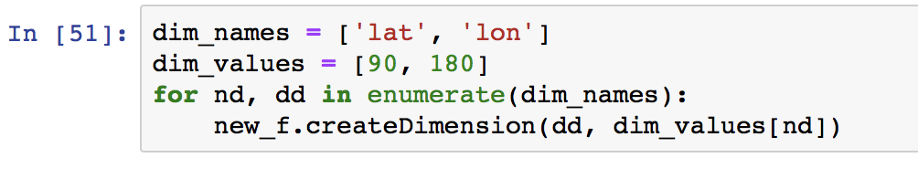
Saving data to a new netcdf file → setting up the dimensions
There are several ways to do this. Some from class:
Use a dictionary instead of two lists
Use other functions than enumerate (like zip)
You could just create a list of indices to loop over and then access the information from “dim_names” and “dim_values” using those indices…

Slide 9
Saving data to a netcdf file → creating a variable
Now we can write the data to the netcdf file.
We do this by first creating the variable “new_var” with the method “createVariable” with its name as a string (we will call it meanGPP), data type, and a tuple of strings with its dimensions, e.g.:
new_var = new_f.createVariable('meanGPP', float, ('lat', 'lon’))
We can also set the fill value at this point (which is 9.969209968386869e+36):
new_var = new_f.createVariable('meanGPP', float, ('lat', 'lon’), fill_value=9.969209968386869e+36)

Slide 10
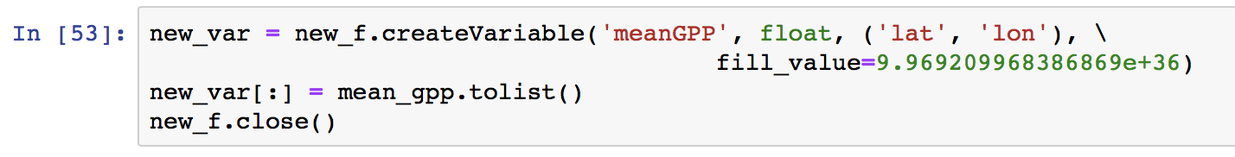
Saving data to a netcdf file → saving data to the new variable
We then write the mean_gpp array to this newly created variable using the command:
new_var[:] = mean_gpp.tolist()
Then we can close the file using new_f.close()
You now have a new netCDF file with mean GPP stored in it.

Slide 11
Today’s in-class exercise part B
To complete the in-class exercise from Monday’s class:
Create a new variable with the total GPP over time (not a spatial average – just considering the 1st dimension).
Plot the total GPP and add a colorbar and a plot title.
Save that new array to a new netcdf file following the notes in class.
You can always re-open the file and plot the mean GPP to check it has saved properly, or download Panoply and use it to open the file to check the mean GPP has saved.
Upload your Jupyter Notebook AND your newly saved netcdf file to Canvas before the start of next class.

